Slide 1
File Management
P N
Reference:
Operating Systems- Concepts and Design- Milan Milenkovic

Slide 2
Introduction
The file management system is supposed to hide all device specific aspects of file manipulation from users and to provide them with an abstraction of a simple, uniform space of named files.

Slide 3
Responsibilities of File Management System
Mapping of access requests from logical to physical file-address space.
Transmission of file elements between main memory and secondary storage.
Management of the secondary storage such as keeping track of the status, allocation and deallocation of space.
Support for protection and sharing of files and the recovery and possible restoration of files after system crashes.

Slide 4
Command Language User’s View Of The File System
Users of files may be broadly classified as :
Command-Language Users
System Programmers
File Directories in computer system belong to one of two categories: Single-Level or Hierarchical.

Slide 5
Advantages of Hierarchical Directory
Unique naming of files
Support for selective sharing and protection
Convenient directory manipulation

Slide 6
Command Language File Services- General File Manipulation
CREATE filename
DELETE filename(s)
RENAME old filename, new filename
ATTRIBUTES filename(s), attributes
COPY source_filename(s), destination_filename(s)

Slide 7
Directory Manipulation
DIR dirname
MAKE_DIR dirname
REMOVE_DIR dirname
CHANGE_DIR dirname

Slide 8
Volume/Media Manipulation
INITDISK drivername
MOUNT drivername/volumename
DISMOUNT volumename
VERIFY volumename
BACKUP source_file(s)/ volume, destination_file(s)/volume
SQUEEZE volumename

Slide 9
Systems Programmers View Of The File System
Run-Time File Services
READ filename, number_bytes, in_buffer
WRITE filename, number_bytes, out_buffer
SEEK filename, logical position
OPEN filename, access_mode
CLOSE filename

Slide 10
Typical File Operations
CREATE
SEEK
CLOSE
READ OR WRITE
OPEN

Slide 11
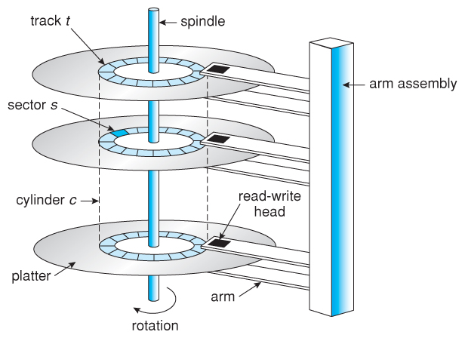
Disk Organization
Disks can be removable or fixed- depending on whether or not the recording platters can be removed from the drive
Disk platters are constantly rotated by the drive mechanism at a speed of 3000rpm or higher

Slide 12
Disk Access Time
Access Time
Access Time is defined as the setup time before the actual data transfer takes place. For example, the read/write head is on track 1, but we need to read data from another track or segment. Thus, the read/write head will move to the data block location before the actual transfer occurs. This delay is called Access Time.

Slide 13
Access Time is calculated by summation of the following:
Seek Time: The time necessary for the read/write heads to travel to the target cylinder
Seek Time = (Number of tracks/cylinders crossed) * (Time to cross one track/cylinder)
Rotational Latency: The time necessary to access the desired sector is called Rotational latency.
Transfer Time: The time necessary to transfer a sector between the disk and memory buffer

Slide 14
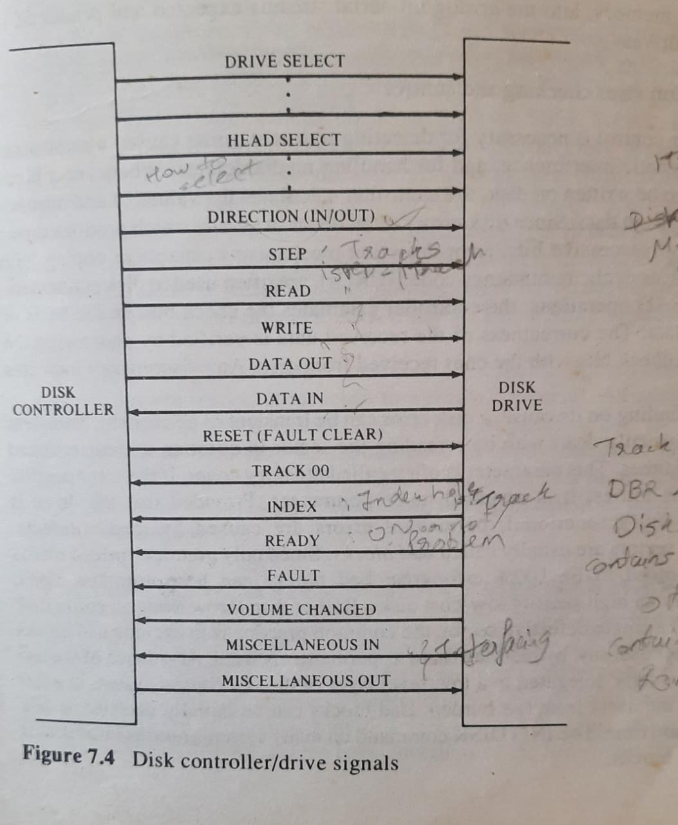
Disk Controller & Driver

Slide 15
The primary functions of a basic disk controller:
1. Convert higher level commands, such as SEEK or READ a sector, into a sequence of properly timed drive-specific commands.
2. Provide serial to parallel conversion and signal conditioning necessary to convert from byte or word format, required for DMA communication with main memory into the analog bit-serial streams expected and produced by disk drives.
3. Perform error checking and control.

Slide 16
Errors can be caused due to noise and electromagnetic interference.
Depending on its cause, a disk error can be transient or permanent.

Slide 17
Bad Blocks
Transient errors are usually dealt with by rereading the sector in question a predetermined number of times. This parameter is called Retry Count.
If error persists after a few retries, it is assumed to be permanent. Provided that the drive is otherwise fully functional , permanent errors are caused by media defects. Defective sectors are called Bad Blocks.
A typical disk driver basically allows reading and writing of disk sectors specified by means of the three component physical disk address of the form:
<cylinder number, head number, sector number>

Slide 18
Operating System’s view of File Management
From the range of services provided to users and the description of the disk organization, it follows that the basic functions of the file system include:
1. Keeping track of all files of the system.
2. Controlled sharing and enforcing of file protection.
3. Management of disk space; allocation and deallocation.
4. Mapping of logical file addresses to physical disk addresses.

Slide 19
File-System Layers
 | Objects Manipulated | Typical Calls
Interactive Users (Command language) | FILES | COPY, DELETE, RENAME
Application & System Programs (Run-Time Calls) | FILE ELEMENTS (File-Relative logical addresses) | OPEN, CLOSE, SEEK, READ, WRITE
FILE SYSTEM
Device Driver | SECTORS (Cylinder, Head, Sector) | SEEK, READ, WRITE

Slide 20
Contd..
The following three levels of device abstraction and disk storage addressing are commonly identifiable in implementations of the file management systems.
File relative logical addressing (filename, offset)
Volume-relative logical addressing. (Sector, offset)
Drive relative physical addressing (cylinder, head, sector).

Slide 21
Directories
Symbolic file directories (SFDs)
Basic File Directory (BFD)
File Control Block (FCB)
Active Name Tables (ANTs)
Active File Tables (AFTs)

Slide 22
Disk Space Management
Contiguous Allocation: - Contiguous allocation is one of the most used methods for allocation. Contiguous allocation means we allocate the block in such a manner, so that in the hard disk, all the blocks get the contiguous physical block.
We can see in the below figure that in the directory, we have three files. In the table, we have mentioned the starting block and the length of all the files. We can see in the table that for each file, we allocate a contiguous block.

Slide 23
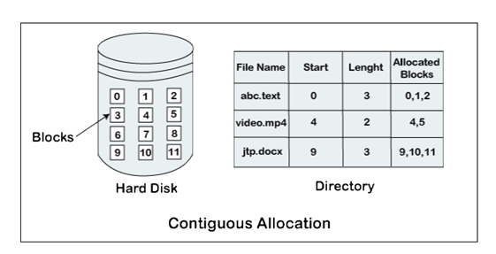

Slide 24
Example of contiguous allocation
We can see in the given diagram, that there is a file. The name of the file is ‘mail.’ The file starts from the 19th block and the length of the file is 6. So, the file occupies 6 blocks in a contiguous manner. Thus, it will hold blocks 19, 20, 21, 22, 23, 24.

Slide 25
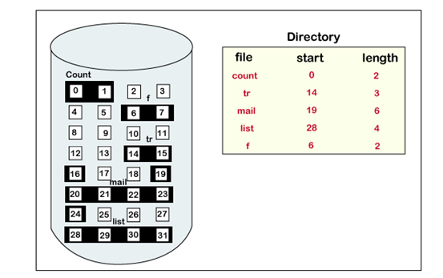

Slide 26
File Access Mechanism
Sequential access
Direct/Random access
Indexed sequential access

Slide 27
Sequential access
A sequential access is that in which the records are accessed in some sequence, i.e., the information in the file is processed in order, one record after the other. This access method is the most primitive one. Example: Compilers usually access files in this fashion.

Slide 28
Direct/Random access
Random access file organization provides, accessing the records directly.
Each record has its own address on the file with the help of which it can be directly accessed for reading or writing.
The records need not be in any sequence within the file and they need not be in adjacent locations on the storage medium.
In direct access or relative access files can be accessed in random for read and write operations. The direct access model is based on the disk model of a file, since it allows random accesses. In this method, the file is divided into numbered blocks. Any of these arbitrary blocks can be read or written. For example, we may read block 8, then write into block 10 and then read block 15. Direct access system is quite useful and mostly databases are of this type.

Slide 29
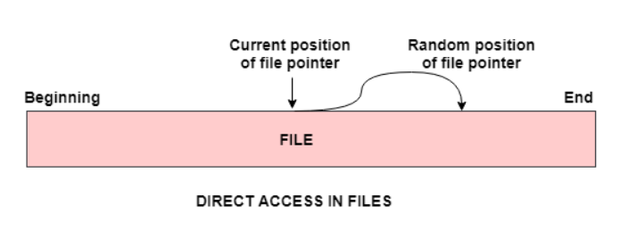
Direct/Random access

Slide 30
Non Contiguous Allocation
Non Contiguous Allocation of disk space, in terms of both files and free space is usually some variation of two basic strategies:
Chaining
Indexing

Slide 31
Chaining
The disk blocks can be scattered anywhere on the disk. The directory entry contains a pointer to the starting and the ending file block. Each block contains a pointer to the next block occupied by the file.

Slide 32
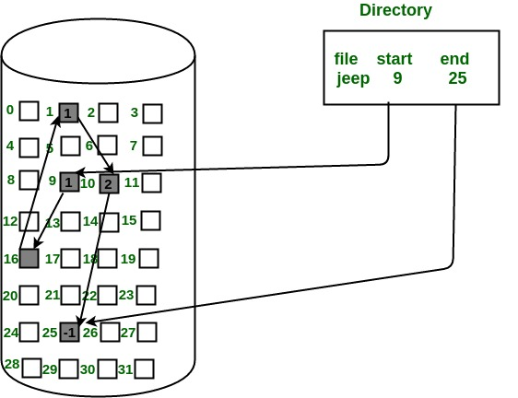
The file ‘jeep’ in following image shows how the blocks are randomly distributed. The last block (25) contains -1 indicating a null pointer and does not point to any other block.

Slide 33
Advantages:
This is very flexible in terms of file size. File size can be increased easily since the system does not have to look for a contiguous chunk of memory.
This method does not suffer from external fragmentation. This makes it relatively better in terms of memory utilization.

Slide 34
Disadvantages
Because the file blocks are distributed randomly on the disk, a large number of seeks are needed to access every block individually. This makes linked allocation slower.
It does not support random or direct access. We can not directly access the blocks of a file. A block k of a file can be accessed by traversing k blocks sequentially (sequential access ) from the starting block of the file via block pointers.
Pointers required in the linked allocation incur some extra overhead.

Slide 35
Indexing
The Indexed allocation method is another method that is used for file allocation. In the index allocation method, we have an additional block, and that block is known as the index block. For each file, there is an individual index block. In the index block, the ith entry holds the disk address of the ith file block. We can see in the below figure that the directory entry comprises of the address of the index block.

Slide 36
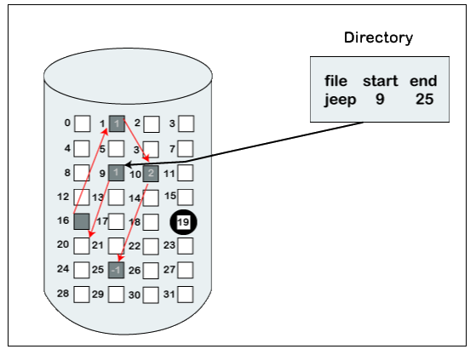
Indexing

Slide 37
Advantages of Index Allocation
The index allocation method solves the problem of external fragmentation.
Index allocation provides direct access.

Slide 38
Disadvantages of Index Allocation
In index allocation, pointer overhead is more.
We can lose the entire file if an index block is not correct.
It is totally a wastage to create an index for a small file.

Slide 39
Disk Caches & Unix Buffer Cache
Maintain a pool of copies of disk blocks in memory and eliminate repeated disk blocks from memory.
In UNIX, cache disk blocks are managed by the kernel and referred to as the buffer cache.
Cache hit: and cache miss

Slide 40
Delayed write in UNIX- read/write
SYNC
SHUTDOWN utility
FSCK-File System check
UNIX Buffer cache.

Slide 41
Advantages of disk caching include:
Improved effective disk access time by satisfying requests for the cached blocks from memory.
Improved response time for applications for cached blocks on reads and, optionally, on delayed writes where the I/O requestor is not forced to wait for the completion of a disk write.
Elimination of some disk accesses, for example, when the same block is written and read in some order.

